Slide 1
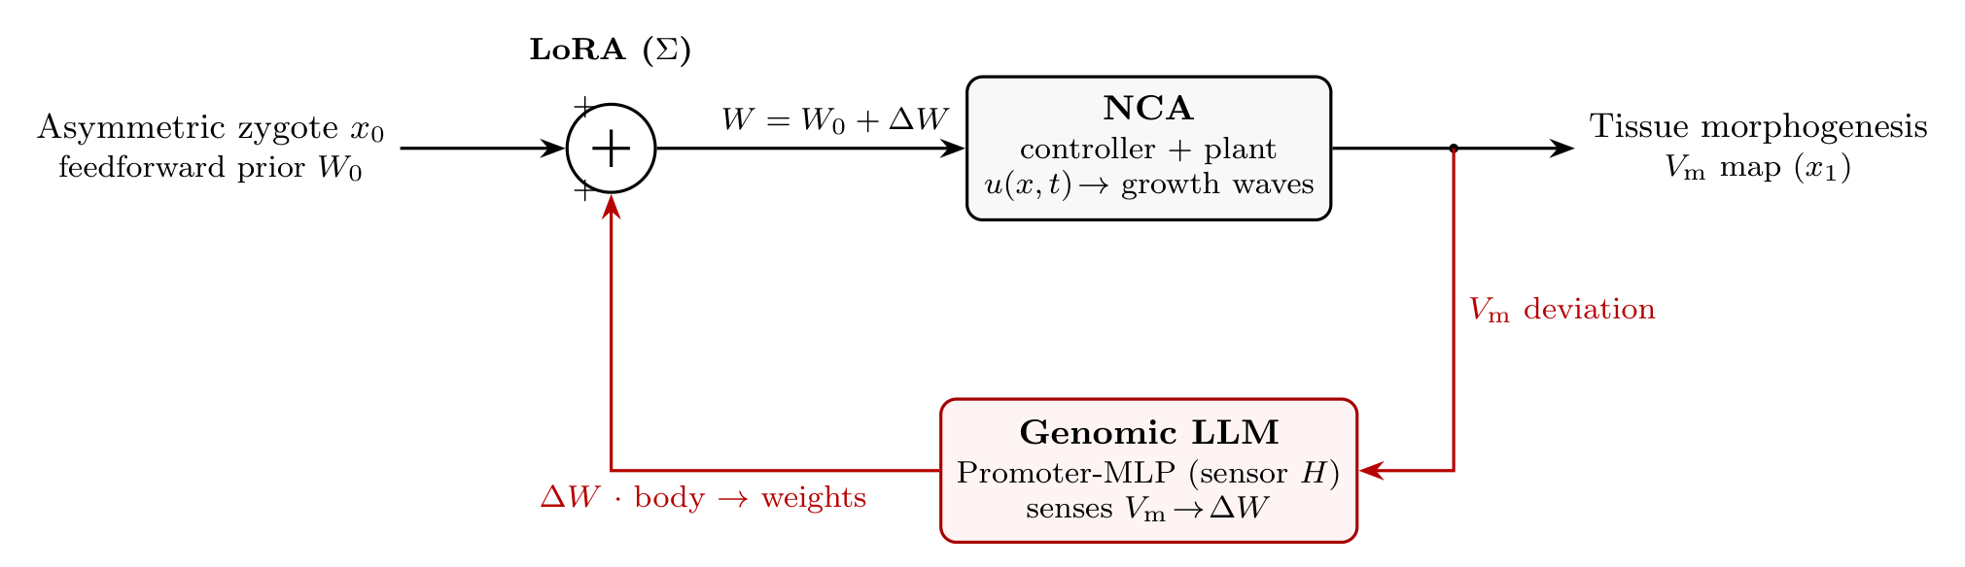
A COMPUTATIONAL THEORY OF DEVELOPMENT · A TEN-PAPER PROGRAM
Cognitive Biology:
Computing the Body from the Genome
An inner neural cellular automaton driven by a frozen large genomic model.
Miles Bradford Jacobs · genetec.io, Cape Town · Nine papers on Zenodo (CC-BY) · one more in preparation

Slide 2
THE SERIES AT A GLANCE
One engine, nine published results — papers 1–9 here; paper 10 in preparation
#1
Cognitive Biology (Foundational)
Zenodo 10.5281/zenodo.20722139
The architecture: NCA + genomic LLM as a two-DOF control loop; computes the vertebrate body plan (6/7) at 97.8% atlas fidelity.
#2
Perceptrons and Morphogen Primordia
Zenodo 10.5281/zenodo.21143761
Glass-box genome→weights; QT-interval GWAS conductance signs validated 7/7; connexin matrix computed, not fit.
#3
Across Phyla
Zenodo 10.5281/zenodo.20746637
One bioelectric operator across 5 species; a substrate reader sets the clade boundary; body-plan topology 3/3.
#4
Organ Formation
Zenodo 10.5281/zenodo.20925727
Organs = master-TF heads read from an accessibility code (p=0.0005); field–form cymatic correspondence ρ=1.00 (face/heart/gut).
#5
Inner vs Outer Perceptron
Zenodo 10.5281/zenodo.21143016
Every coefficient traced to genome×literature; ectopic eye, two-headed planaria, limb inverse-design IoU=1.0.
#6
Computing the Embryo
Zenodo 10.5281/zenodo.21221930
Four morphogenetic heads driven forward on a real atlas (R²=0.85); genome→body in one forward pass.
#7
From Mouse to Human, and the Developmental Loop
Zenodo 10.5281/zenodo.21796907
Adult GWAS read BACKWARD as an embryonic assay; the loop closes on real per-allele effects across heart, eye and kidney.
#8
Differentiation Clocks, Organ Formation and the MLP
Zenodo 10.5281/zenodo.21322049
Each morphogenetic head IS a reaction–diffusion PDE; organ formation as frame → spacing → discretize → cohere.
#9
The Mouse Model and the Head Manifold
Zenodo 10.5281/zenodo.21791849
Dense E16.5; the thin-walled luminal heart resolves the loop (match 0.52→0.88); traits collapse onto a ~7-dim head manifold.
Cognitive Biology · Miles Bradford Jacobs · genetec.io
2

Slide 3
WHAT IT RUNS ON
The sources: a frozen front-end, real atlases at the back
READING THE GENOME — the frozen regulatory code
VALIDATING THE BODY — spatiotemporal atlases
ABC Activity-by-Contact
ZESTA zebrafish Stereo-seq 4D atlas
7.7M enhancer–promoter predictions → the Promoter-MLP conditioning: which enhancer drives which gene.
The spatiotemporal training target; forward field reconstruction reaches R² = 0.85.
SEdb 2.0 super-enhancer catalogue
MOSTA mouse Stereo-seq atlas
The pooled transcriptional attention heads — the cell-identity determinants loaded into the weights.
Held-out vertebrate test of the spatial NCA — R² = 0.70.
AlphaGenome learned DNA→regulation model
HESTA human Stereo-seq atlas
The frozen front-end encoder: generates accessibility, expression and the heads directly from sequence.
Extension of the same pipeline to human development (in progress).
The genome is read on the left and the body is checked against measured atlases on the right — the glue in between is not hand-tuned.
Cognitive Biology · Miles Bradford Jacobs · genetec.io
3

Slide 4
THE UNIFYING IDEA
Development as a closed-loop controller
▸ INNER perceptron — a Neural Cellular Automaton (NCA): local growth-wave dynamics that integrate cell state to the tissue Vₘ map.
▸ OUTER perceptron — a frozen Large Genomic Model (Promoter-MLP): senses the Vₘ deviation and returns a low-rank weight correction ΔW.
▸ The zygote enters as the feedforward prior W₀; the LoRA summing junction forms W = W₀ + ΔW. Open the loop → the conserved phylotypic body; close it → the species- and individual-specific remainder.
Cognitive Biology · Miles Bradford Jacobs · genetec.io
4

Slide 5
THE ZYGOTE SEED W₀
The kernel is a methylation fossil record
▸ The feedforward prior W₀ is not Gaussian noise — it is a structured, tagged DNA archive the embryo inherits (Jadhav et al. 2019).
▸ The archive lives in HYPOMETHYLATED enhancer DNA (low-methylated regions): ~90% of enhancers used in development stay hypomethylated in the adult after every other chromatin mark is erased.
▸ So the inherited weight is hypomethylation DEPTH alone — histone marks are a dynamic activity layer (they live in the ABC / SEdb front-end), not the frozen archive.
▸ Three strata, read like sediment: adult still active, fetal a faded remnant, embryonic a silent memory that carries no other mark.
▸ The telomere→PRC2 clock (next slide) INDEXES into this archive, de-repressing the tagged enhancers in reverse developmental order. The kernel stores WHEN; the Vₘ field stores WHERE.
ADULT
13,076
LMRs (29%)
LMR + H3K4me1 + H3K27ac
active now
FETAL
2,843
LMRs (6%)
LMR + H3K4me1
mid-gestation remnant (E14.5–16.5)
EMBRYONIC
29,466
LMRs (65%)
LMR only — the sole surviving tag
earliest, silent memory (FOX dev TFs)
surface / recent → deep / ancient · ~45,385 real adult LMRs (mouse, GSE111024)
Cognitive Biology · Miles Bradford Jacobs · genetec.io
5

Slide 6
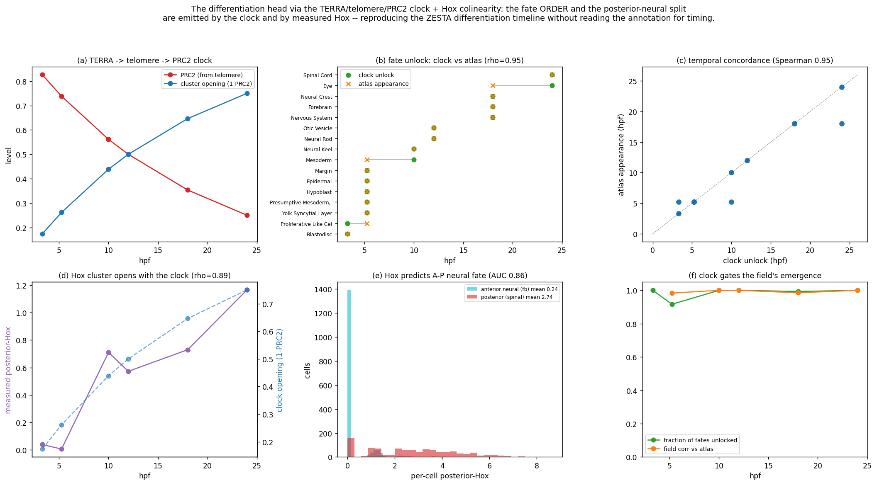
THE DEVELOPMENTAL CLOCK
Hox · PRC2 · TERRA — the axis of WHEN
▸ Development is initialised by a chromosomal CLOCK, not a wiring diagram: a telomere-gated PRC2 withdrawal reading the methylation-tagged zygote kernel (the Jadhav enhancer fossil record).
▸ TERRA → telomere → PRC2 withdrawal sets WHEN each fate unlocks — clock order matches the atlas appearance order at Spearman ρ = 0.95.
▸ Hox colinearity sets WHERE along the body: measured Hox opens with the clock (ρ = 0.89) and predicts posterior-neural fate at AUC = 0.86.
▸ Two orthogonal control axes: the chromosome is the CLOCK (WHEN); the bioelectric Vₘ field is the MAP (WHERE).
▸ The clock GATES the field — differentiation unlocks in order, reproducing the timeline without reading the annotation.
Telomere→PRC2 clock (ρ=0.95) and Hox colinearity (AUC=0.86) drive the field forward.
Cognitive Biology · Miles Bradford Jacobs · genetec.io
6

Slide 7
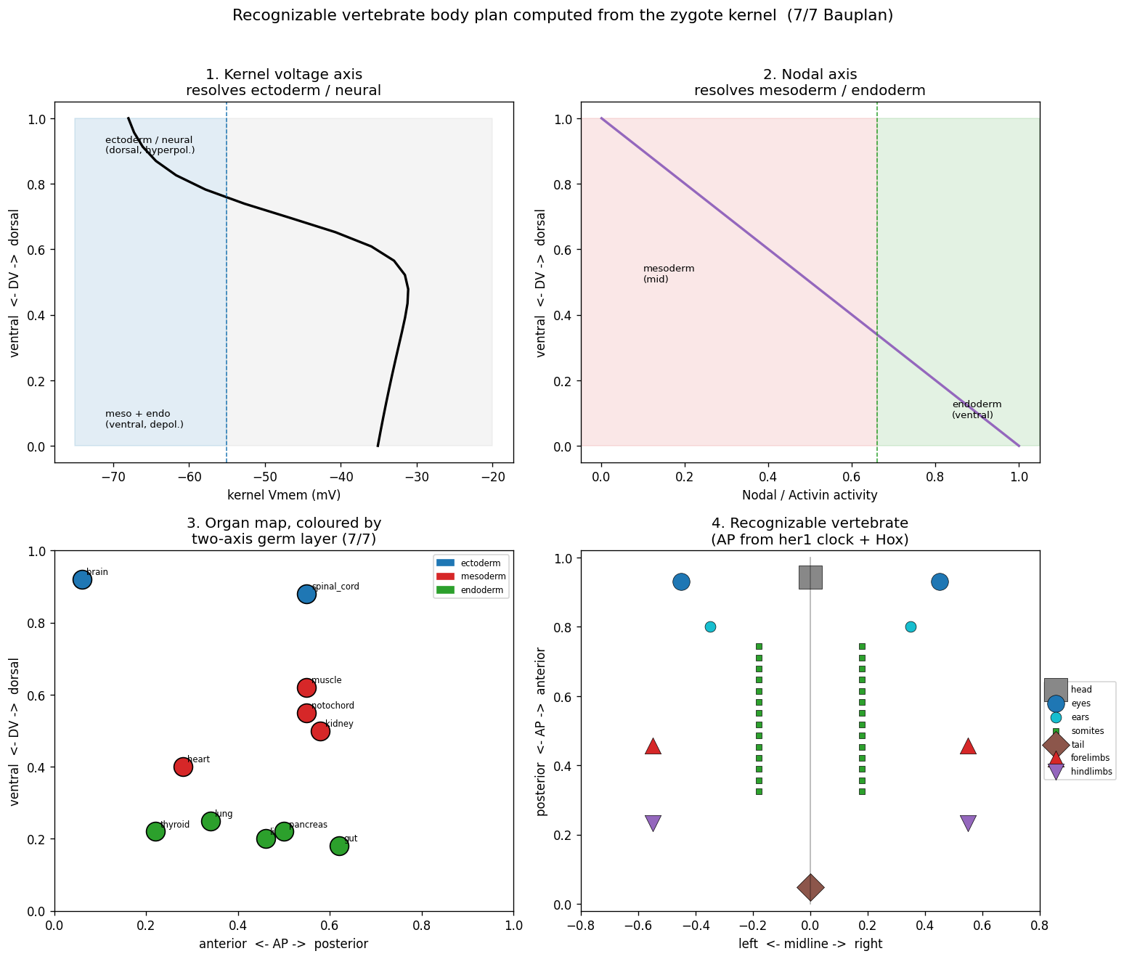
PAPER 1 · FOUNDATIONAL
The body plan computed from the zygote kernel
▸ The developmental AXES — the anterior–posterior, dorsal–ventral and left–right positional gradients — are chosen by hand and supplied to the genome as its positional frame.
▸ With those axes set, the frozen zygote kernel + forward loop TURNED UP the correct vertebrate Bauplan — 6 of 7 axes right — computed, not drawn.
▸ So the claim is scoped honestly: the genome computes the body plan GIVEN the frame; the axes are an input, not yet derived.
▸ Framed as a JEPA: the model predicts the bioelectric Vₘ latent, never molecular “pixels”; the genomic LLM is the encoder (genes are literal A,T,G,C).
▸ Validated against the 12-stage Silic zebrafish atlas at 97.8% in-window agreement.
Right body plan from the kernel, given the chosen axes (6/7).
Cognitive Biology · Miles Bradford Jacobs · genetec.io
7

Slide 8
DEEP TIME
Body plans as accreted attention heads and axes
Evolution did not rewrite the mechanism — it accreted attention heads, axes and masks one clade at a time (a nested LoRA stack over the phylogeny). Complexity tracks head count, not gene count.
Era / clade
Innovation
Component added
Prokaryotes (~3.8 Ga)
ion channels, Vₘ
Body-Plan Head (1st axis)
Eukaryotes (~2.0 Ga)
histones, PRC2
Chromatin Head + Polycomb Mask
Sponges (~800 Ma)
Wnt signalling
Morphogen Head (2nd; oral–aboral)
Cnidarians (~600 Ma)
gap junctions, 2nd axis
Connexin Head (3rd)
Bilaterians / insects (~550 Ma)
Hox cluster, segments
Polycomb Mask → temporal (clock)
Vertebrates (~500 Ma, 2×WGD)
4 Hox clusters, neural crest
full 6 heads + SE Head + all masks
Amniotes / reptiles (~300 Ma)
elaborate enhancers
Promoter MLP
Mammals (~200 Ma)
diverse ion channels
Channel MLP
The two vertebrate whole-genome duplications — one Hox cluster to four — are the single largest parameter-expansion event in the history of life.
Cognitive Biology · Miles Bradford Jacobs · genetec.io
8

Slide 9
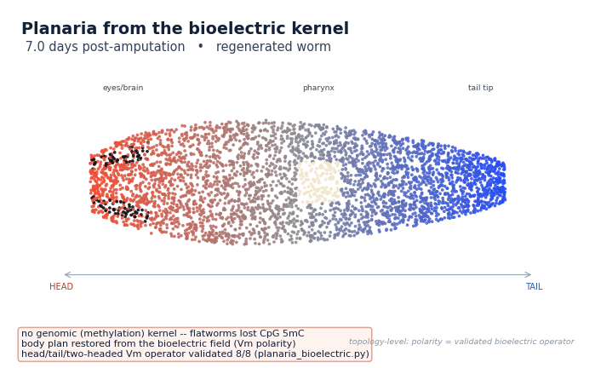
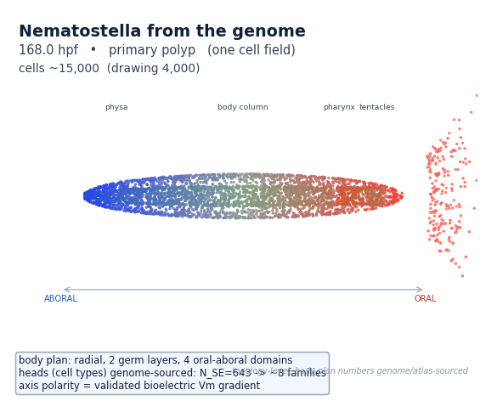
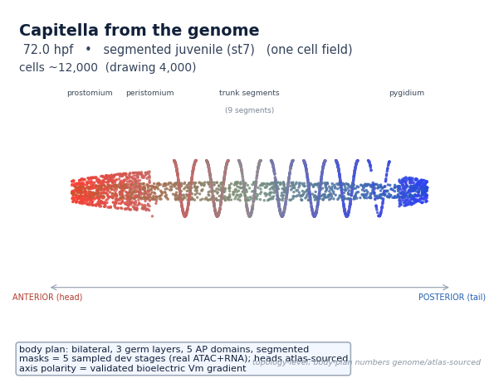
PAPER 3 · ACROSS PHYLA
One operator, many bodies — the reader sets the boundary
The same bioelectric operator, grown forward from the genome into three different phyla:
Planaria — regeneration
Nematostella — anemone
Capitella — segmented worm
▸ The same Goldman / gap-junction operator runs across a five-species cycle — only the substrate READER changes (methylation for vertebrates, ATAC universally).
▸ Cross-phylum Vₘ validation: planaria 8/8 · zebrafish 7/7 · Xenopus ρ=0.83 · mouse AUC 0.74. One generator reproduces planaria / Nematostella / zebrafish topology — 3/3.
Cognitive Biology · Miles Bradford Jacobs · genetec.io
9

Slide 10
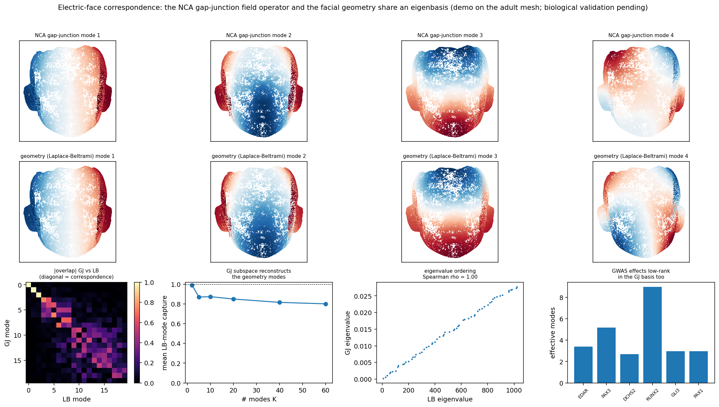
PAPER 4 · ORGAN FORMATION
Organs as master-TF heads — and the field–form correspondence
▸ Organs modelled as master-transcription-factor heads read from an accessibility code.
▸ Stage 1: organ heads self-assign with recall 23.9% vs 4.3% chance — p = 0.0005 (8/14 correct).
▸ Field–form correspondence: the genome’s bioelectric target is low-rank in the cymatic modes of its OWN gap-junction operator (1.8 effective modes).
▸ Those modes ARE the geometry modes of the FaceBase face — correlation ρ = 1.00, subspace capture 0.87.
▸ Extends to two real electrical syncytia: heart-LV (capture 0.99) and gut-tube slow wave (0.998); mode 1 = each organ’s true activation axis.
Gap-junction field modes = facial geometry modes (ρ=1.00).
Cognitive Biology · Miles Bradford Jacobs · genetec.io
10

Slide 11
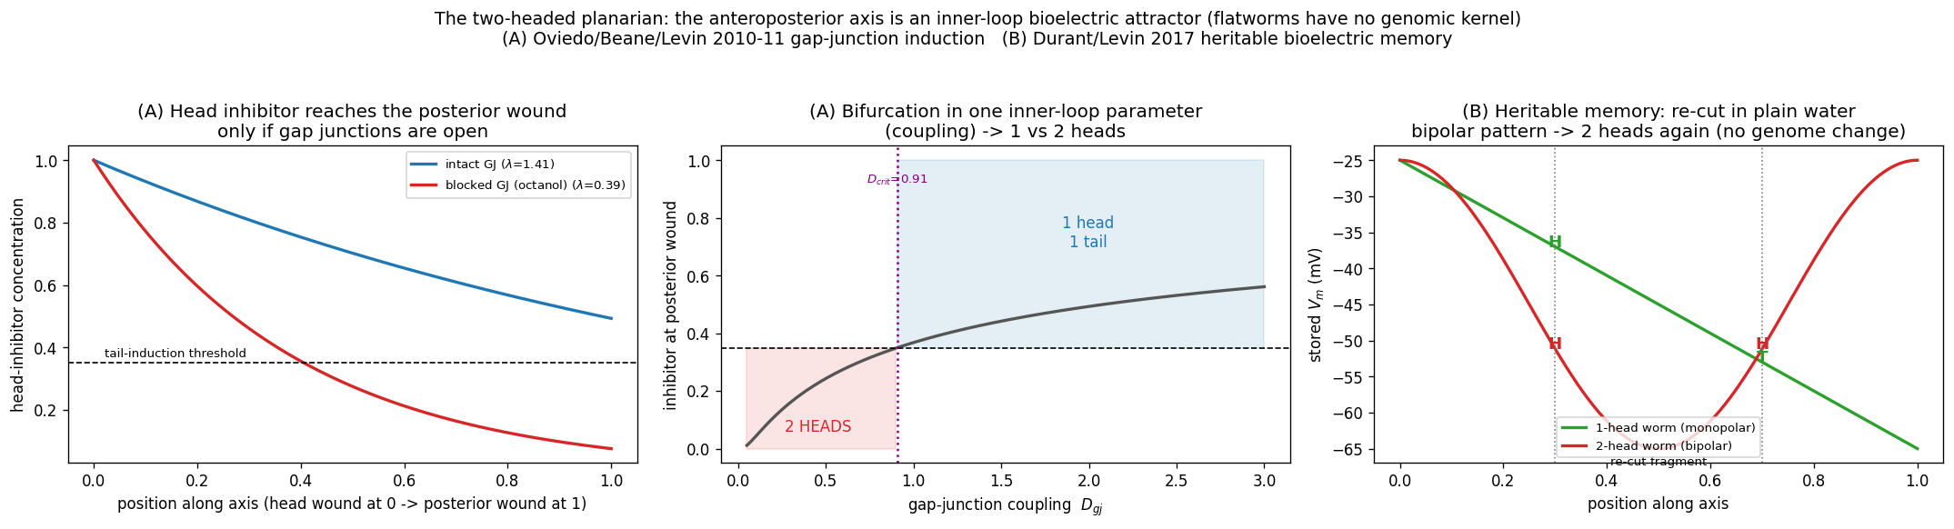
PAPER 5 · INNER-LOOP BISTABILITY
The two-headed planarian — a bioelectric memory
▸ Flatworms regenerate with no genomic “head” kernel — the antero-posterior axis is set by an inner-loop BIOELECTRIC attractor.
▸ Oviedo / Beane / Levin (2010–11): briefly lowering gap-junction coupling flips the axis from one head to TWO — a pitchfork bifurcation in the coupling (panels A–B).
▸ Durant / Levin (2017): the two-headed pattern is HERITABLE — re-cut in plain water it regenerates two heads again, with NO change to the genome (panel C).
▸ Pure inner-loop multistability: one genome, two stable attractor states of the field — the pattern lives in the bioelectric state, not the sequence.
Cognitive Biology · Miles Bradford Jacobs · genetec.io
11

Slide 12
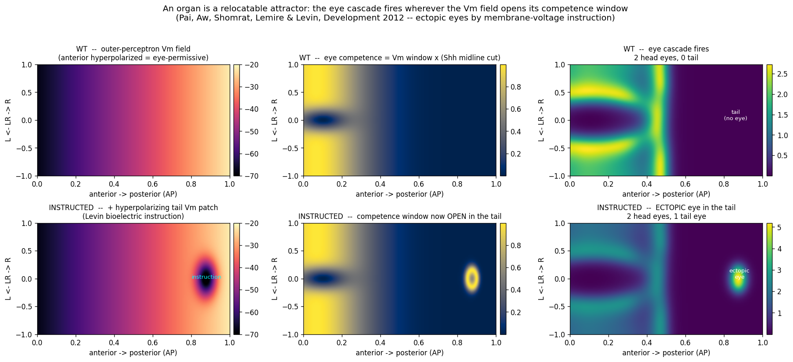
PAPER 5 · A RELOCATABLE ATTRACTOR
The ectopic eye — an organ is a field attractor
▸ Pai, Aw, Shomrat & Levin (Development 2012): a hyperpolarizing Vₘ patch in the gut or TAIL of Xenopus induces a complete ectopic eye — far outside the head field.
▸ In the framework the eye is a RELOCATABLE ATTRACTOR: the outer perceptron fires the eye cascade wherever the Vₘ field opens its competence window — not where coordinates say.
▸ Top row (WT): the window sits in the anterior hyperpolarized zone. Bottom row (instructed): a tail Vₘ patch opens a second window → an eye grows in the tail.
▸ Position is read from the bioelectric map, not from a genomic coordinate — the field is the instruction.
The eye cascade fires wherever the Vₘ field opens its competence window (Pai et al. 2012).
Cognitive Biology · Miles Bradford Jacobs · genetec.io
12

Slide 13
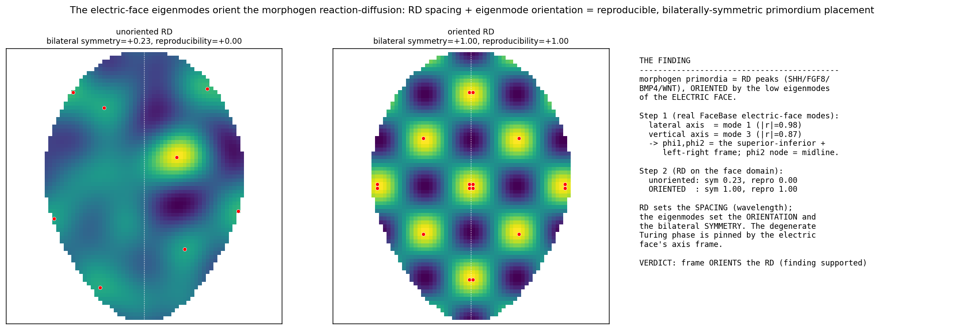
A DISCOVERY WITHIN PAPER 6
The “electric face” — primordia placed on the frame
▸ The morphogen primordia — the SHH / FGF8 / BMP4 / WNT reaction–diffusion peaks — land on the ANTINODES of the embryo’s low gap-junction eigenmodes (the body-axis frame, next slides).
▸ The frame supplies orientation and bilateral symmetry; the reaction–diffusion supplies only spacing. Once oriented, placement reproducibility goes 0.00 → 1.00 — the electric face.
Cognitive Biology · Miles Bradford Jacobs · genetec.io
13

Slide 14
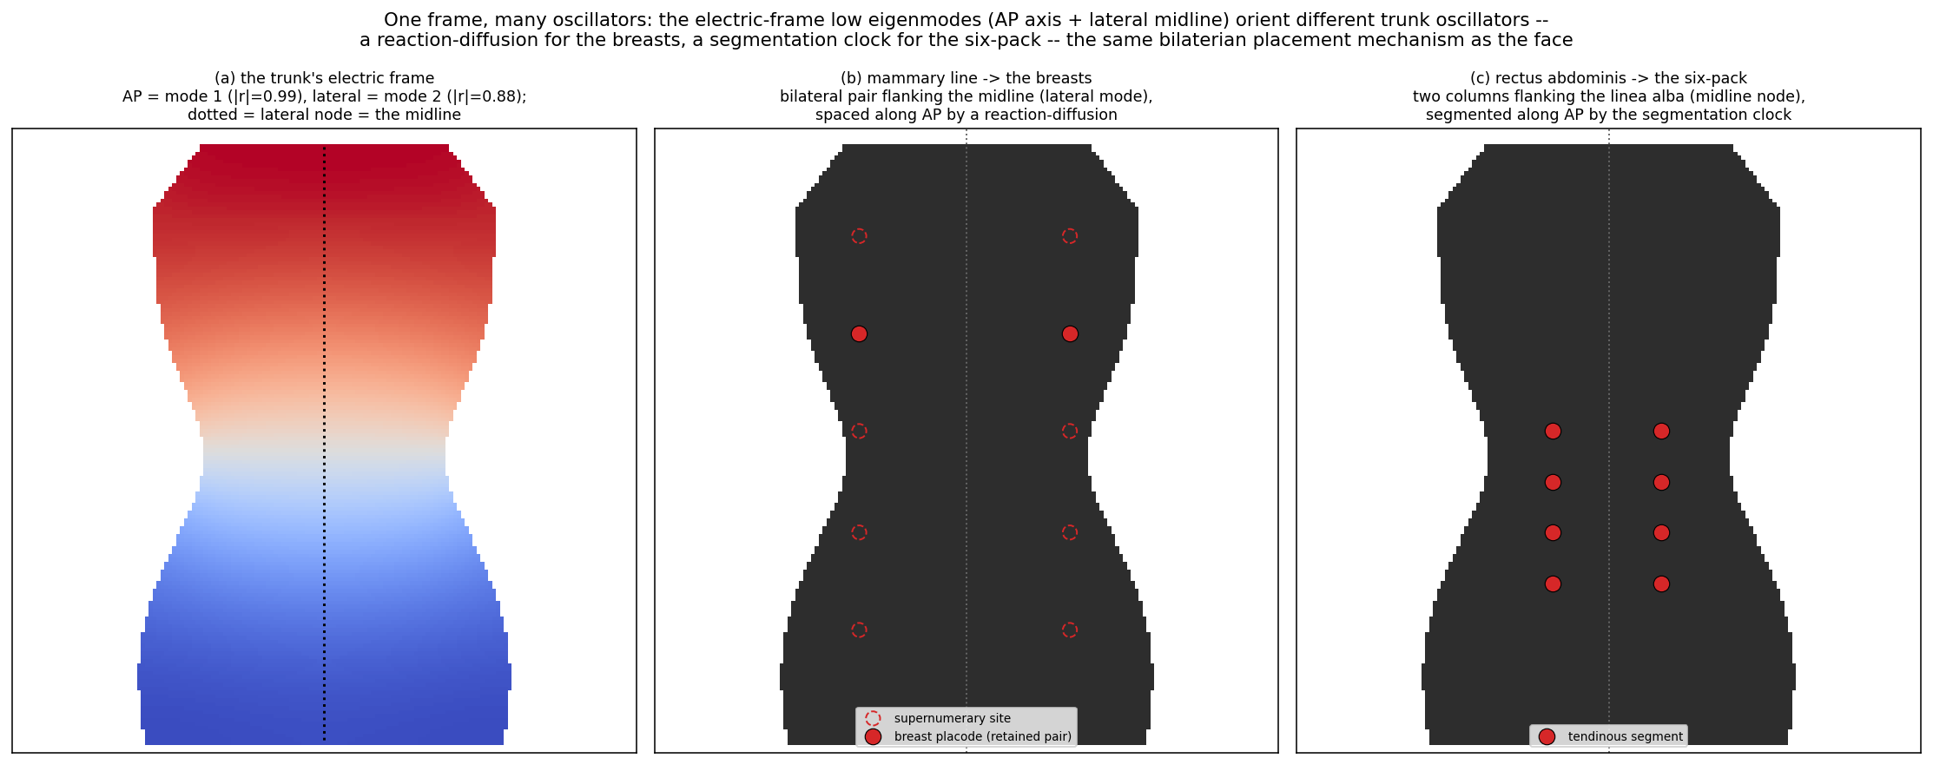
THE ELECTRIC BODY · ONE FRAME, MANY OSCILLATORS
The same frame places the breasts and the six-pack
The lateral eigenmode’s node is the midline, so both features arrive in bilateral pairs; a reaction–diffusion spaces the mammary line, a segmentation clock stripes the rectus abdominis — the same bilaterian placement mechanism as the electric face.
Cognitive Biology · Miles Bradford Jacobs · genetec.io
14

Slide 15
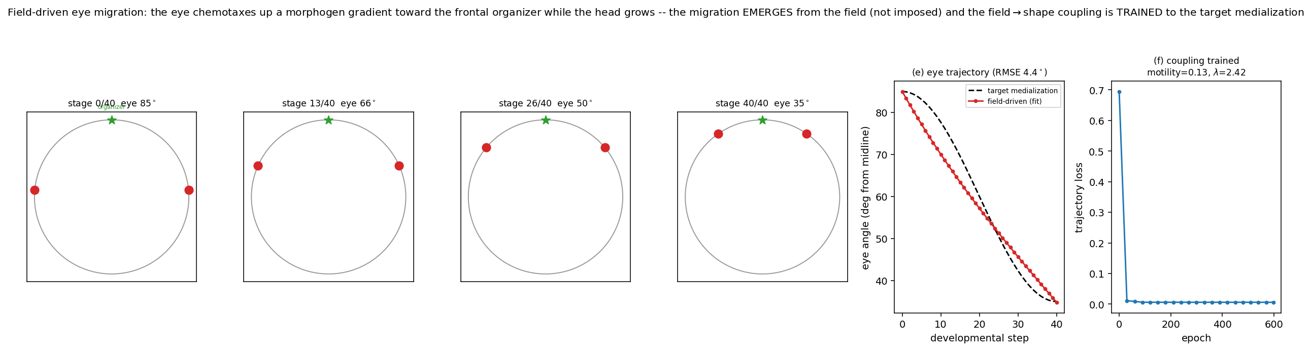
PAPER 6 · MOVING-BOUNDARY MORPHOGENESIS
Eye medialization — migration driven by the field
▸ In the human atlas (HESTA) the eyes begin LATERAL and rotate FRONTAL as the head grows — the medialization every human face undergoes (the flatfish is the extreme).
▸ Cause made explicit: a frontal organizer emits a morphogen; the eye primordium chemotaxes up the gradient and migrates frontally while the head grows underneath it.
▸ The trajectory is NOT imposed — it emerges from the field on the growing head; and being a differentiable function of the coupling (motility, morphogen length-scale), the coupling is TRAINED to the target.
▸ The eye rotates 85° → 35° from the midline, matching the target to RMSE 4.4°. Under-drive it and the eye stays lateral — hypertelorism.
Cognitive Biology · Miles Bradford Jacobs · genetec.io
15

Slide 16
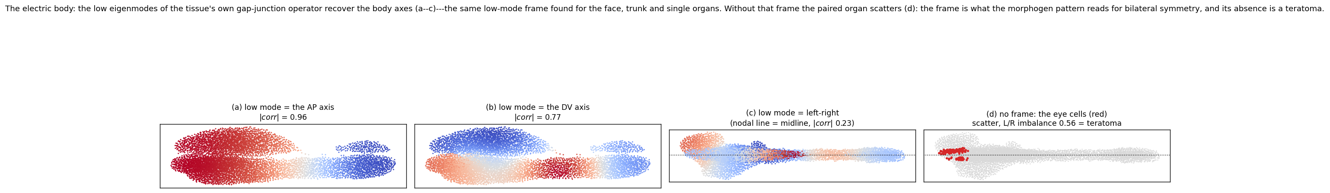
THE ELECTRIC BODY · THE FISH EIGENMODES
The embryo’s gap-junction eigenmodes ARE the body axes
(a) AP axis
(b) DV axis
(c) Left–Right
(d) No frame
low mode = anterior–posterior
low mode = dorsal–ventral
the mode’s NODE is the midline
eye cells scatter, L/R imbalance
|corr| = 0.96
|corr| = 0.77
|corr| = 0.23
→ a teratoma
The same low-mode frame recurs in the face, trunk and single organs. Without it the paired organs scatter — the frame is what the morphogen pattern reads for bilateral symmetry, and its absence is a teratoma.
Cognitive Biology · Miles Bradford Jacobs · genetec.io
16

Slide 17
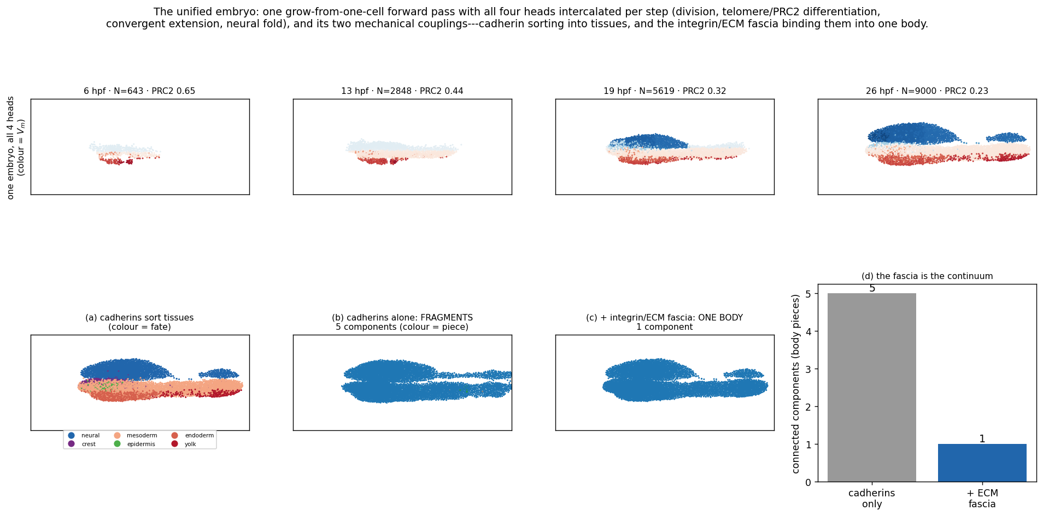
PAPER 6 · COMPUTING THE EMBRYO
Genome to body in one forward pass
▸ Four morphogenetic heads wired and driven forward on a real spatiotemporal atlas (ZESTA zebrafish, R² = 0.85).
▸ Differentiation clock (Spearman 0.95) · division (0.94) · migration = convergent extension ×3.2 shape · shape = fold / cleft.
▸ The four heads intercalate into ONE grow-from-a-single-cell embryo: 45 → 2600 cells, clock-ordered.
▸ Shape-head knockdown reproduces neural-tube defect and harelip (Fiedler λ₂ buckling) — the birth-defect / medicine link.
▸ The capstone existence-proof: the anatomical compiler, end to end.
The unified single-forward-pass embryo (4 heads intercalated).
Cognitive Biology · Miles Bradford Jacobs · genetec.io
17

Slide 18
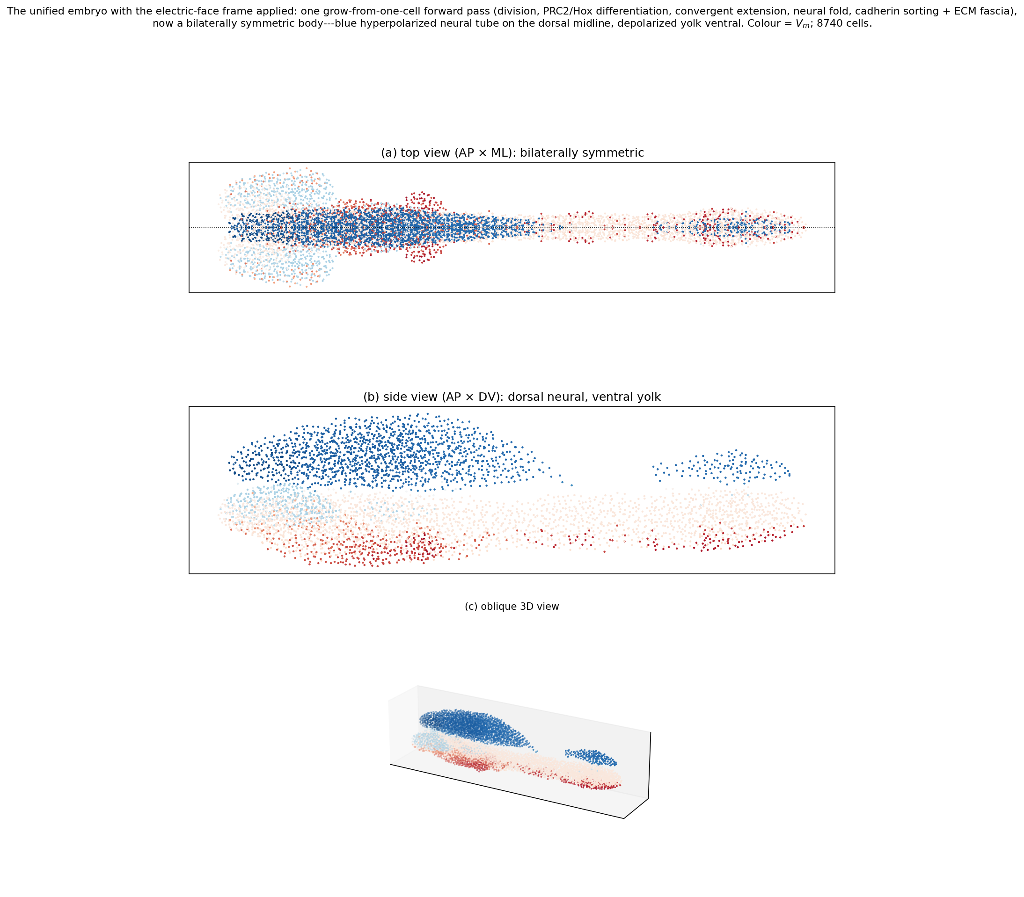
LATERAL INHIBITION MAKES THE SYMMETRY
A bilaterally symmetric embryo, computed
The frame sets the axes — but SYMMETRY is made by lateral inhibition.
A von Dassow–Odell lateral-inhibition neural field on the electric frame resolves a symmetric eye PAIR — each eye suppressing a second on its own side.
No lateral inhibition → placement stays unresolved.
Weaken the frame → the pair collapses to cyclopia.
Cognitive Biology · Miles Bradford Jacobs · genetec.io
18

Slide 19
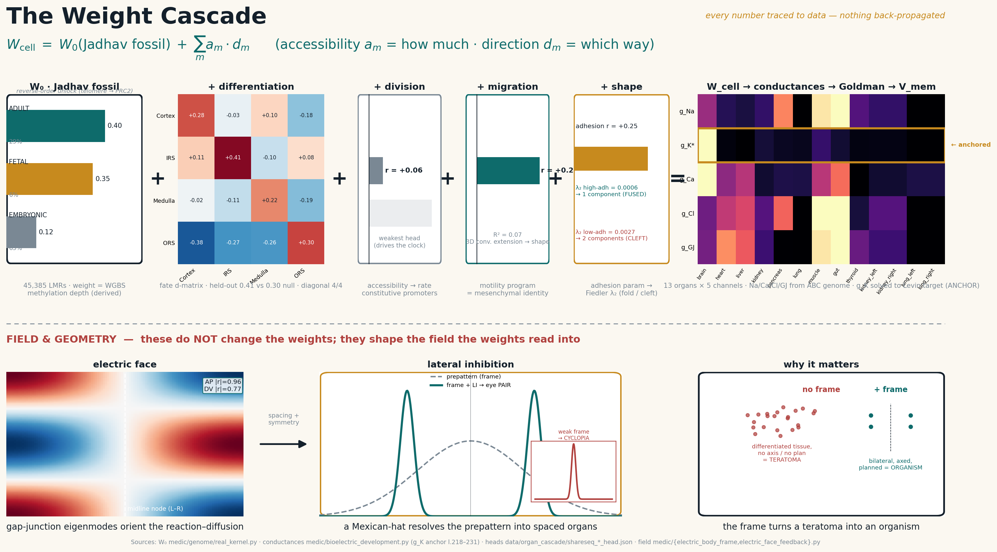
THE GLASS BOX · UNDER THE HOOD
Building the cell's weights from the genome
Cognitive Biology · Miles Bradford Jacobs · genetec.io
19

Slide 20
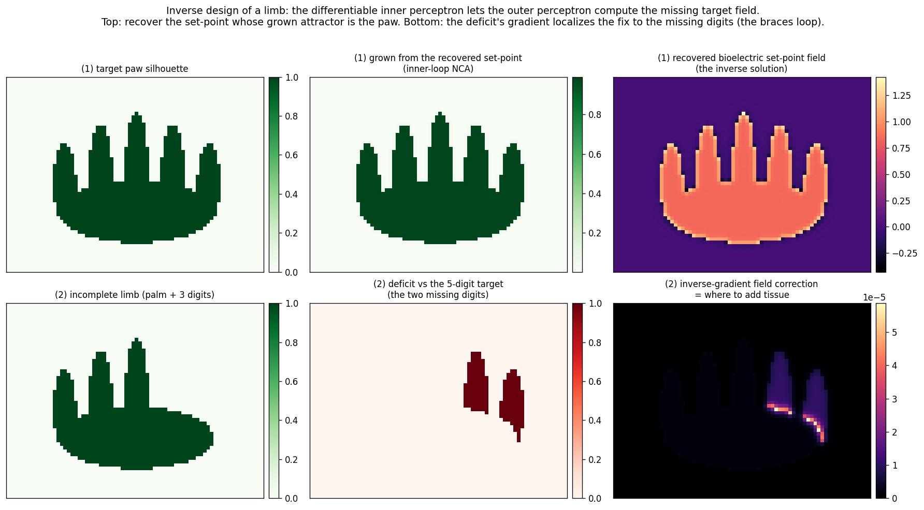
PAPER 5 · INNER VS OUTER PERCEPTRON
Inverse design — recreating the limb from its anatomy
THE ANATOMY IS THE INPUT — THE GENOME’S TARGET FIELD IS COMPUTED. Limb recovered at IoU = 1.0.
▸ The differentiable inner NCA lets the outer perceptron run development BACKWARD: given a target anatomy, solve for the bioelectric set-point whose grown attractor is that shape.
▸ Top row: the target paw is recovered and grown back — match at IoU = 1.0.
▸ Bottom row: the deficit’s gradient says WHERE to add tissue — the regeneration / “braces” loop.
▸ Glass box throughout: every coefficient = a genomic parameter × a literature equation.
Recover the set-point whose grown attractor is the paw (top); the deficit’s gradient localizes the missing digits (bottom). The inverse of growth, computed.
Cognitive Biology · Miles Bradford Jacobs · genetec.io
20

Slide 21
BEYOND THE FOUNDATIONAL SIX · THE REFRAMING
Morphogenesis as Stable Diffusion
GENOME → outer LGM emits the head weights
▸ Each morphogenetic head is literally a reaction–diffusion PDE: the MLP is the REACTION term (a genome-conditioned per-cell nonlinearity); the gap-junction Laplacian is the DIFFUSION term.
▸ Turing (1952) is the foundational special case — here the reaction is READ from the genome, not a fixed cubic, so the same operator paints any pattern.
▸ Iterating the operator on a structured seed is denoising — the same computation as Stable Diffusion, but conditioned on the genome and seeded by the Jadhav kernel (a tagged prior, not Gaussian noise).
▸ One picture for all four heads: differentiation, division, migration and shape are reaction–diffusion channels on the ONE gap-junction operator.
▸ The unifying statement (Papers 6 & 8): morphogenesis is genome-conditioned Stable Diffusion.
▼
REACTION
f(c ; genome)
the MLP head
DIFFUSION
D ∇²c
gap-junction Laplacian
+
▼
iterate the operator on a structured seed = denoising
∂c/∂t = f(c ; genome) + D ∇²c
MORPHOGENESIS =
GENOME-CONDITIONED STABLE DIFFUSION
Cognitive Biology · Miles Bradford Jacobs · genetec.io
21

Slide 22
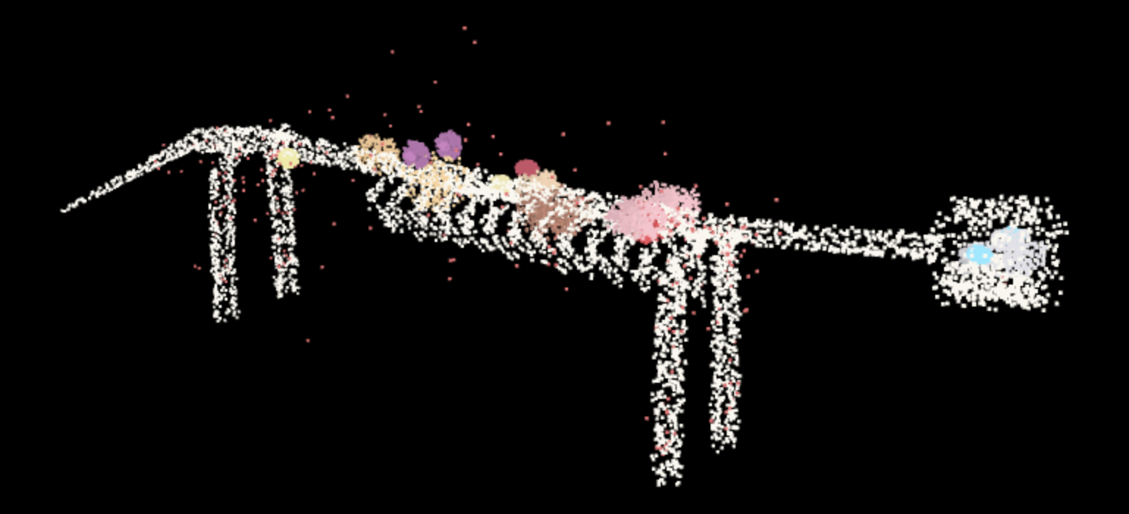
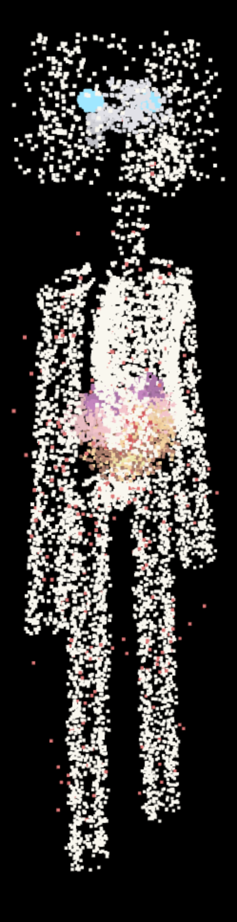

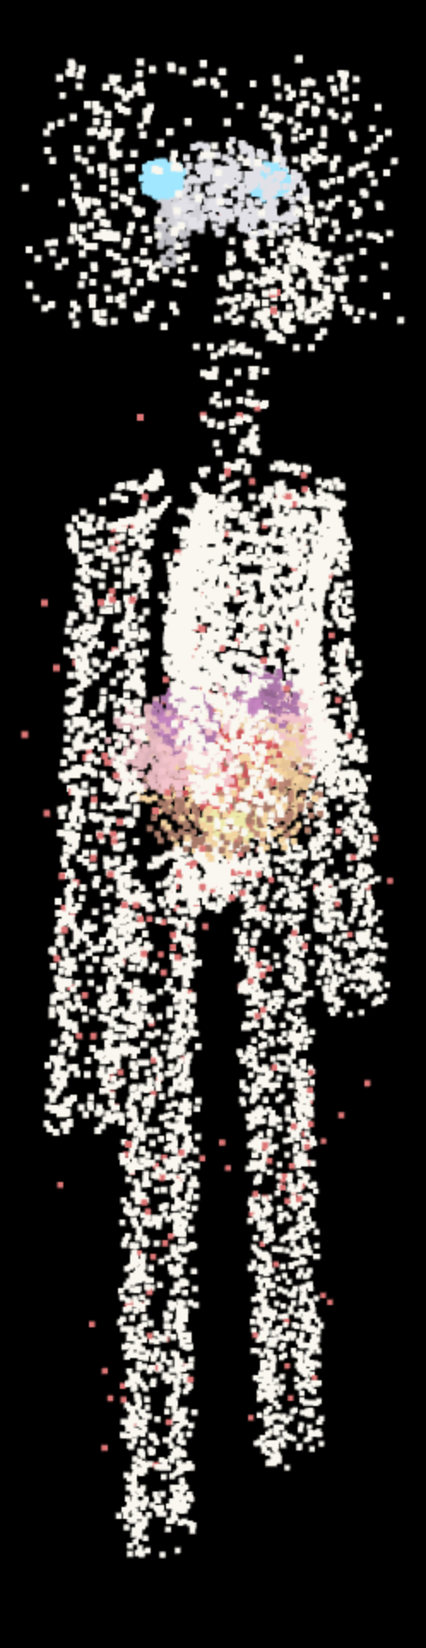
ARTIFICIAL LIFE · ONE DEVELOPMENTAL ENGINE
One kernel — the vertebrate and the human
The general vertebrate — the homologous atlas decoded from the genome, from the interactive 3D viewer.
Human male — another low-rank adapter (bipedal, same kernel).
▸ The same conserved Bauplan and ONE developmental engine build every body — each species is a low-rank adapter (LoRA) on the shared kernel.
▸ Both are the full anatomical atlas — skeleton, Hill-muscles and organs — decoded from the genome and captured from the interactive 3D viewer; the eyes are highlighted in cyan.
▸ Left: the general vertebrate — the quadruped archetype. Right: the human male — bipedal posture on the same kernel, the 7 cervicals still frozen.
▸ The claim to Artificial Life: one grounded, falsifiable encoding — not the arbitrary L-system / NCA / CPPN encodings.
Cognitive Biology · Miles Bradford Jacobs · genetec.io
22

Slide 23
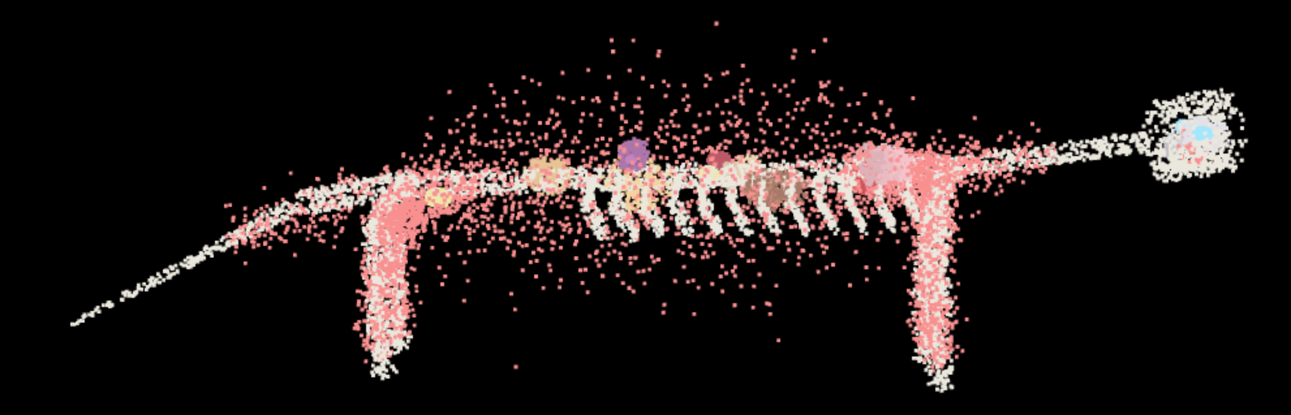
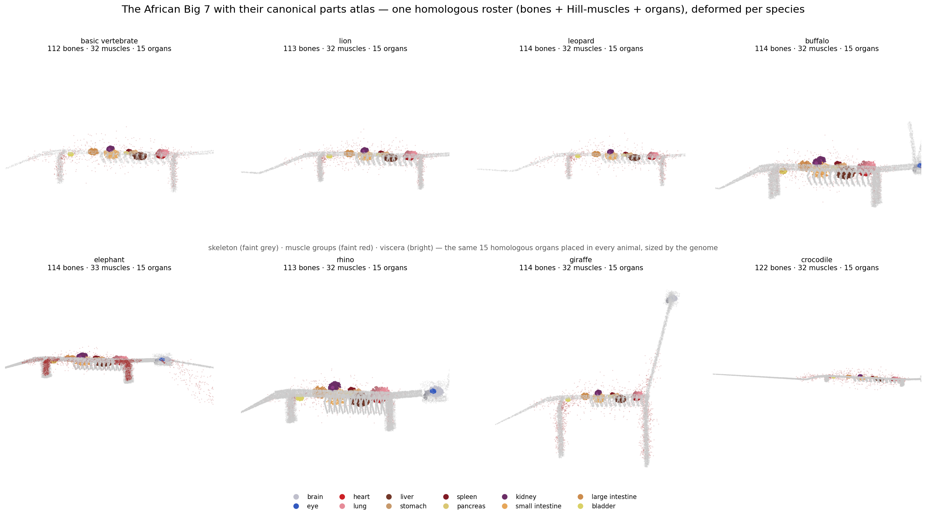
PAPER 9 · GROSS ANATOMY
Hill organs — the homologous parts atlas
▸ Every animal is built from ONE homologous roster: ~112 bones + ~32 Hill-type muscle groups + 15 organs — the “Hill organs” (bones–muscles–viscera; Hill = the muscle-actuator model).
▸ The roster is the kernel; each species is a low-rank DEFORMATION of it, placed by the same genome that grew the embryo (the other animals are on the last slide).
▸ Muscles are defined functionally — origin + insertion on named bones + the joint they actuate — so the atlas is already the musculoskeletal object a controller drives.
■ bones ■ Hill-muscles ■ organs ■ eyes
The basic vertebrate, side view — bones (ivory), Hill-muscles (red) and organs; the roster every species deforms (3D viewer).
Cognitive Biology · Miles Bradford Jacobs · genetec.io
23

Slide 24
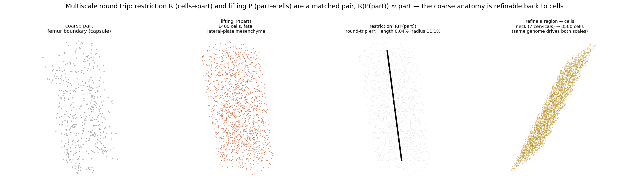
PAPER 9 · MULTISCALE
Multiscale modelling - Restriction, lifting and renormalization
▸ Restriction R (cells → part): coarse-grain a cloud of cells into a named coarse organ (PCA axis-fit → capsule).
▸ Lifting P (part → cells): solid-fill a part’s boundary back with fate-tagged cells — growth’s attractor infill, reused as an operator.
▸ The pair is consistent: R(P(part)) ≈ part — the femur round-trips to 0.04% length error. The genome is the cross-scale invariant that drives BOTH scales.
▸ This is equation-free / renormalization-by-eigenmodes (E & Engquist; Kevrekidis): the “Engquist organs” are the named coarse-grainings read straight off the NCA + LGM.
Cognitive Biology · Miles Bradford Jacobs · genetec.io
24

Slide 25
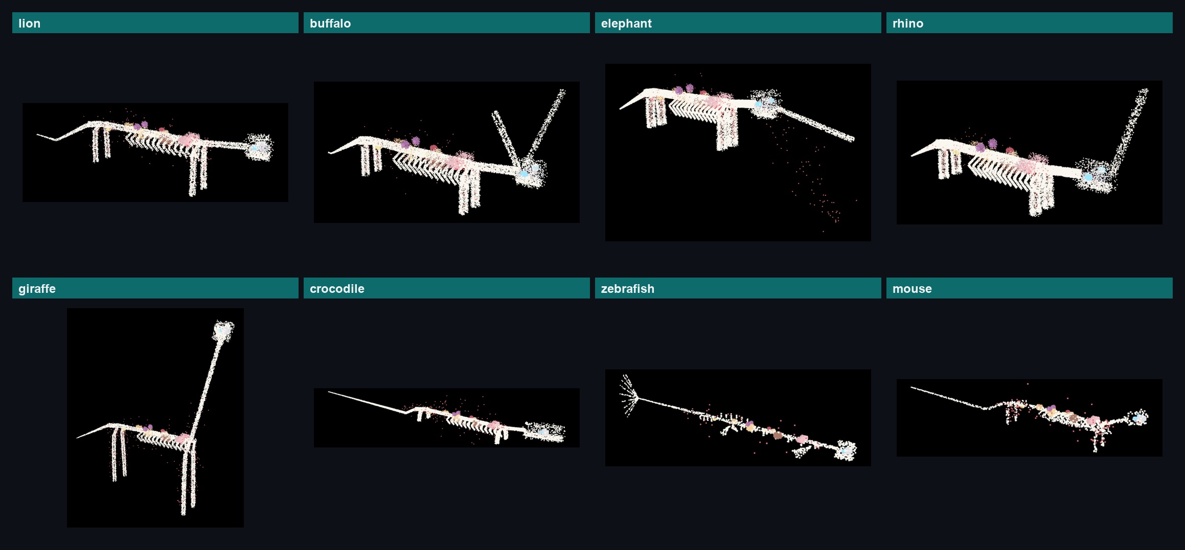
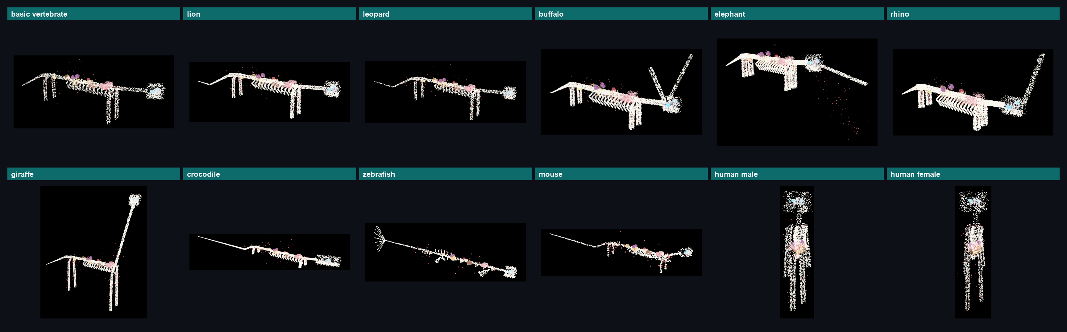
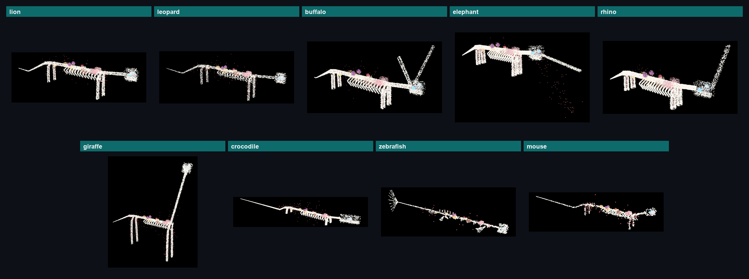
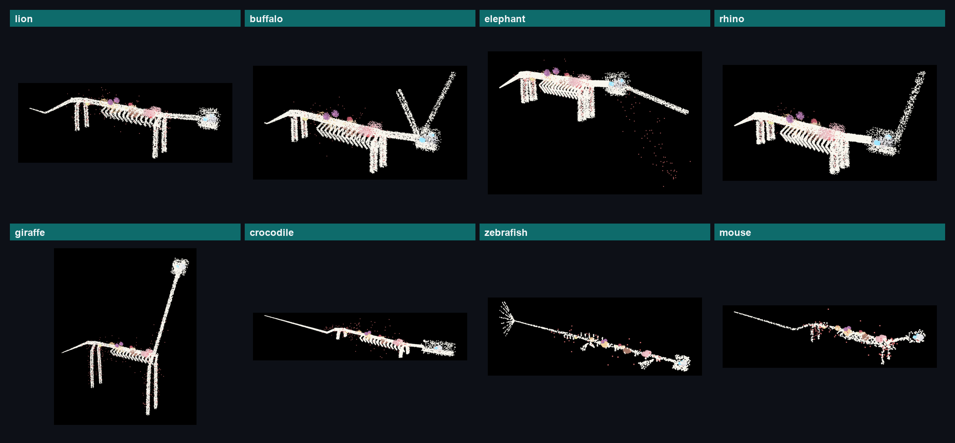
ARTIFICIAL LIFE · THE MENAGERIE
The menagerie — one engine, the whole zoo
The rest of the zoo — lion, buffalo, elephant, rhino, giraffe and crocodile, plus the mouse (MOSTA) and zebrafish (ZESTA) the model is trained on — eight bodies decoded from one genome by the same method (the vertebrate and the human are on the previous slide).
The zebrafish's fins are the SAME appendage genes as the tetrapod limbs (deep homology). Full anatomical atlas: skeleton (ivory) + Hill-muscles + organs, eyes cyan.
Cognitive Biology · Miles Bradford Jacobs · genetec.io
25

Slide 26
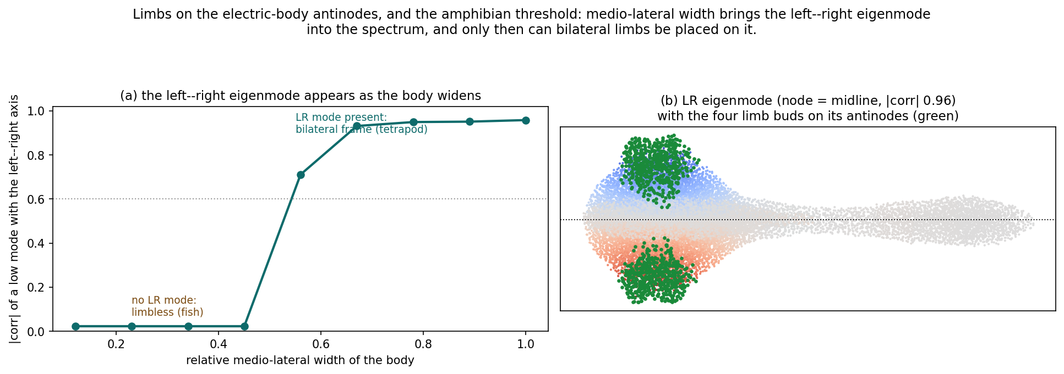
BEYOND THE FOUNDATIONAL SIX · THE ELECTRIC BODY
The amphibian threshold — limbs from the electric body
▸ Limbs are placed on the ANTINODES of the electric-body eigenmodes — the same frame as the face, the mammary line and the six-pack. The AP eigenmode gives the Hox fore/hind levels; the LR eigenmode (node = midline) gives the two bilateral sides.
▸ The LR eigenmode exists only if the body has medio-lateral WIDTH — its eigenvalue scales as 1/width². A thin, convergent-extension-collapsed body has NO LR mode → limbless: a fish.
▸ Widen the body and the LR mode drops into the spectrum (|corr| 0.02 → 0.96) → the four bilateral limbs appear on its antinodes.
▸ That geometric threshold IS the fish→tetrapod transition — the amphibians. Same paired-appendage genes (deep homology, fin ↔ limb); only the frame that positions their output changes.
Cognitive Biology · Miles Bradford Jacobs · genetec.io
26

Slide 27
ACT III · TOWARD THE DETAILED HUMAN
The series has grown: four more results
The same engine, carried from the embryo to a scored, detailed, individual human body. Three published, one in preparation.
#7
From Mouse to Human, and the Developmental Loop
Zenodo 10.5281/zenodo.21796907
Adult GWAS read BACKWARD as an embryonic assay; the loop closes on real per-allele effects across heart, eye and kidney.
#8
Differentiation Clocks, Organ Formation and the MLP
Zenodo 10.5281/zenodo.21322049
Each morphogenetic head IS a reaction–diffusion PDE; organ formation as frame → spacing → discretize → cohere.
#9
The Mouse Model and the Head Manifold
Zenodo 10.5281/zenodo.21791849
Dense E16.5; the thin-walled luminal heart resolves the loop (match 0.52→0.88); traits collapse onto a ~7-dim head manifold.
#10
Assembling the Body by Relational Attractors
preprint in preparation
Suborgan families + organ↔organ rearrangement (inversions 35→0); a Gray's per-part scorecard reaches 0.979 across 294 parts.
Everything that follows is scored part-by-part against real, isolated human anatomy — the bar is to mirror Gray's, structure by structure.
Cognitive Biology · Miles Bradford Jacobs · genetec.io
27

Slide 28
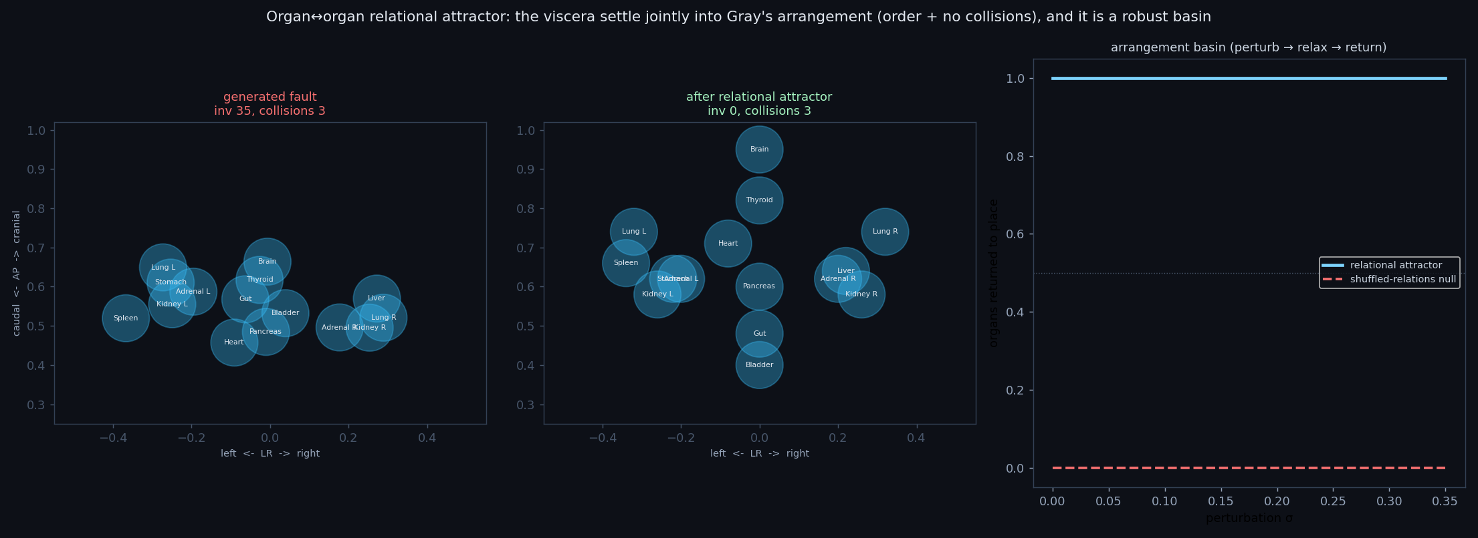
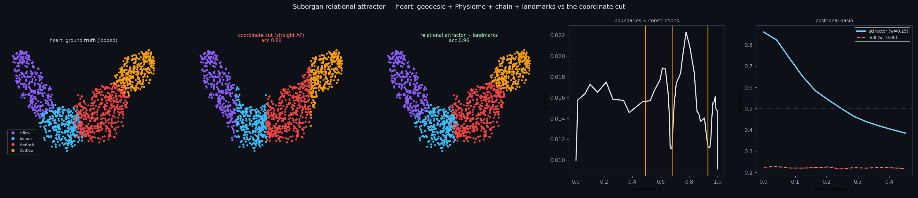
PAPER 10 · ASSEMBLING THE BODY
Relational attractors, and mirroring Gray's Anatomy
▸ The one thing the model lacked was a RELATIONAL attractor over relative position — placement was a coordinate cut, so organs sagged, collided and inverted.
▸ A suborgan FOUNDATION covers every internal topology: chain (heart / gut / cochlea / brain), shell (kidney / adrenal), tree (lung), blob — each recovered to >0.96 from the coordinate cut.
▸ Above them, an organ↔organ attractor stores Gray's pairwise offsets and relaxes the 15 viscera jointly: AP inversions 35→0, a convex, self-correcting basin.
▸ Laterality (Nodal/Pitx2) and the D-looped heart tube are WIRED into the build: arrangement objective 0.75→0.067, Gray's integrity holds 13/13.
▸ A Gray's per-part scorecard scores every one of 294 named structures in isolation → mean 0.979, 281 fully pass.
Viscera relax jointly into Gray's arrangement (inversions 35→0); the looped heart chambers, which no coordinate cut can order.
Cognitive Biology · Miles Bradford Jacobs · genetec.io
28

Slide 29
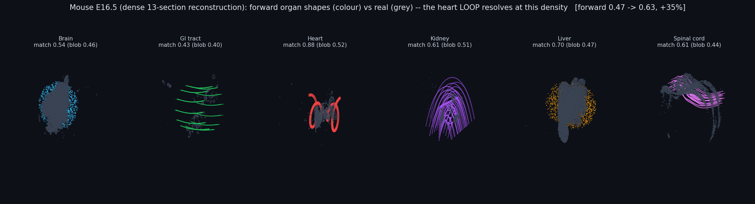
PAPER 9 · THE MOUSE MODEL
Shape from the genome: the luminal heart resolves the loop
▸ Every generated organ is scored against a DENSE 13-section E16.5 reconstruction (~208k real cells) — all six beat a shapeless-cloud null, 0.47 → 0.63 (+35%).
▸ The heart is grown as a thin-walled LUMINAL tube, not a solid coil: the winding wall forces the geodesic along the loop → tortuosity 4.8 vs the real 4.5.
▸ Growing the LUMEN, not just the mass, is what lets the metric see the loop — heart match 0.52 → 0.88, now the best-matching organ.
▸ The many measurable traits are not independent: they collapse onto a low-rank ~7-dimensional head-coupling manifold (measured three ways).
Cognitive Biology · Miles Bradford Jacobs · genetec.io
29

Slide 30
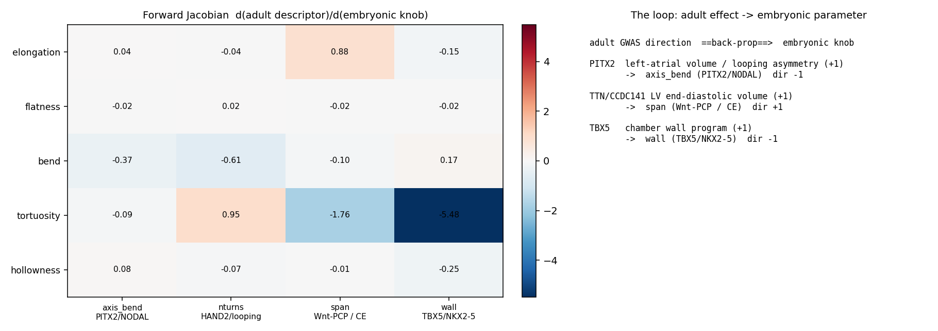
PAPER 7 · FROM MOUSE TO HUMAN
The developmental loop: reading adult GWAS backward
▸ The human is a frozen mouse KERNEL + a low-rank species adapter + a low-rank INDIVIDUAL adapter: ΔW = Σ βₖ eₖ (GWAS gives magnitude, the front-end gives direction).
▸ The named principle — the developmental loop: the embryo CAUSES the adult, so data-rich adult GWAS is an indirect assay of data-scarce embryonic regulation, read backward through the forward model.
▸ It closes end-to-end on REAL per-allele effects across three embryonic behaviours: heart looping (PITX2/TTN), optic-cup fold and ureteric branch.
▸ The liver is the honest contrast — its volume GWAS partitions to the MATURATION layer, so the loop separates the timing of gene action rather than assuming it.
A cardiac forward Jacobian — an adult GWAS direction back-propagates to the embryonic knob that set it.
Cognitive Biology · Miles Bradford Jacobs · genetec.io
30

Slide 31
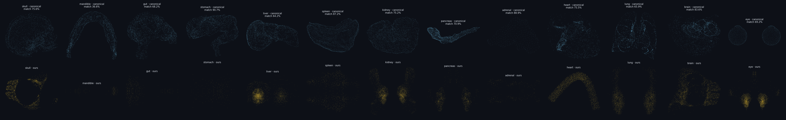
BEYOND THE PAPERS · THE CANONICAL HUMAN
Every part scored against real, isolated anatomy
87.5%
250 / 294
0.979
73.7 → 80.4
whole-body silhouette D2 vs the FMA7163 skin
named parts wired to an isolated canonical mesh
Gray's per-part identity scorecard
organ shape D2 after the aspect-knob search
▸ Each generated bone, muscle and organ is scored by a rotation/scale-invariant shape signature (D2) against its ISOLATED OpenAnatomy / BodyParts3D mesh — the ruler, not a hand-drawn schematic.
▸ Placement is measured too: organ dorso-ventral depth is driven to the REAL in-situ depths measured from BodyParts3D in the whole-body skin frame (kidney dorsal, heart/liver ventral), not a guessed constant.
▸ The whole body is the outer surface of a nested flesh stack — skin over fat over muscle over bone — scored against the canonical standing human (BodyParts3D skin, FMA7163).
Cognitive Biology · Miles Bradford Jacobs · genetec.io
31

Slide 32
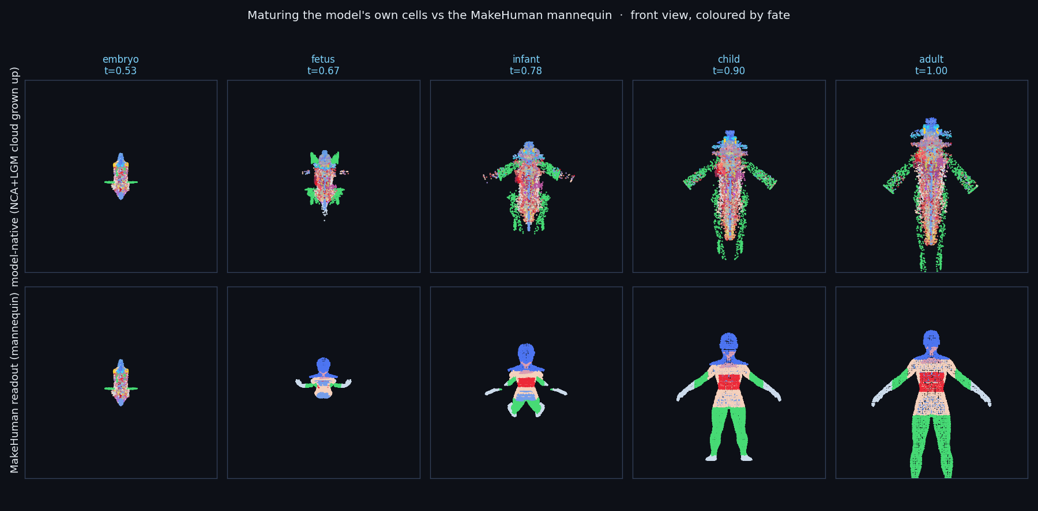
ONE ENGINE, ONE CLOCK, FROM A SINGLE CELL
A detailed human body, grown and matured
Top: the NCA + LGM cell cloud, coloured by fate, matured embryo → fetus → infant → child → adult on the single developmental clock. Bottom: the same stages read out against a MakeHuman mannequin. The adult carries a full skeleton, named muscle bellies, lateralised viscera and a draped skin silhouette — a detailed body generated from the genome, not sculpted.
Cognitive Biology · Miles Bradford Jacobs · genetec.io
32

Slide 33
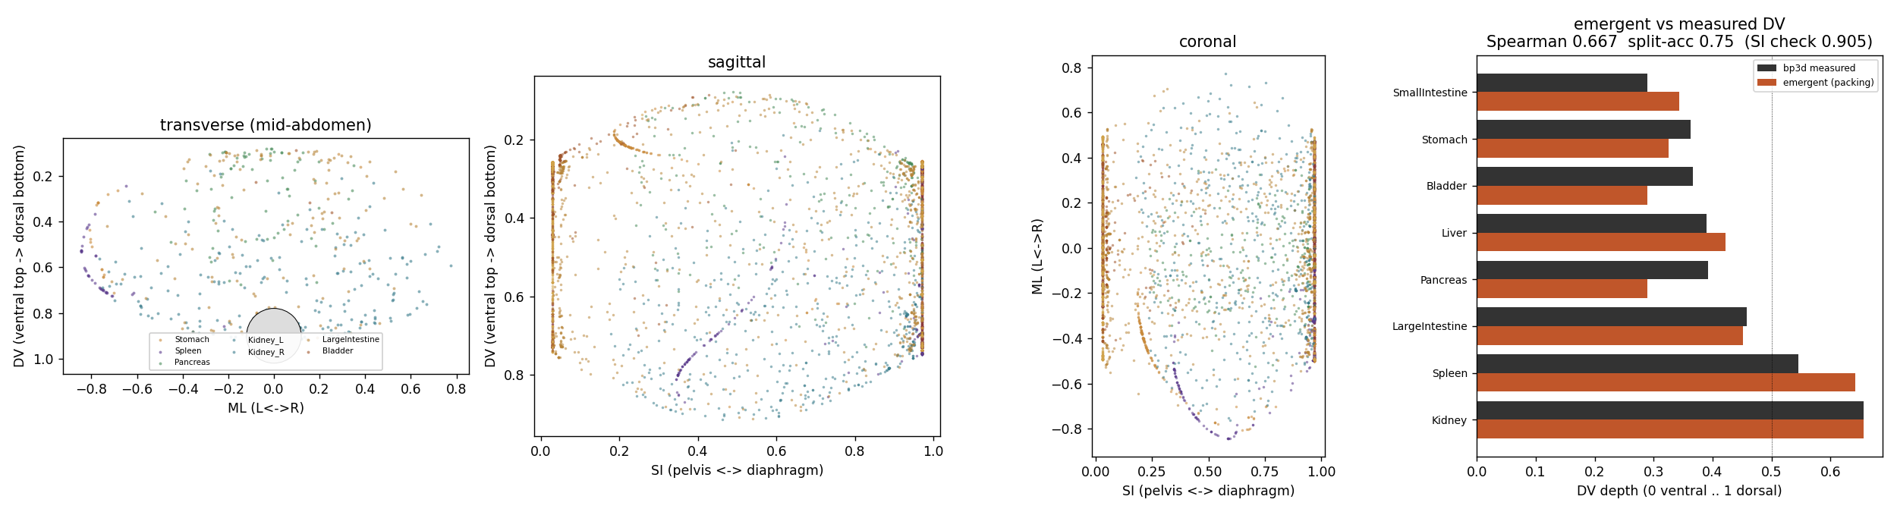
THE HONEST SCOPE · WHAT STAYS A FIT
The physics boundary: information, form, and the packing of organs
▸ Split the body in two. The INFORMATION — which organ where, the axes, the branching plan, identity — is almost entirely genetic, and that is the half the engine computes.
▸ The FORM and FIT of soft tissue is co-produced with physics: the abdominal viscera pack like near-incompressible bags in a closed cavity under gravity.
▸ A soft-body packing solver reproduces the dorso-ventral order from a two- to three-class membrane fact alone (Spearman 0.75) — mechanism replacing a placement.
▸ Principle: provide the ENVIRONMENT (cavity, gravity, contact, pressure) and let the tissue relax; do not provide the FLOW. Searched knobs are effective parameters for the physics not yet simulated — stated, never hidden.
Cognitive Biology · Miles Bradford Jacobs · genetec.io
33

Slide 34
WHAT THE SERIES ESTABLISHES
An anatomical compiler you can read
▸ ONE engine — inner NCA + outer frozen genomic model — spans systems, phyla, organs and the whole embryo.
▸ It is a GLASS BOX: every layer has an assay and every coefficient traces to genome × literature, not a fitted black box.
▸ It computes forward (body plans, organ fields, a full embryo) and inverts (limb IoU 1.0, ectopic organs, planarian axes).
▸ The bioelectric field is the shared intermediate — the same operator, re-read per clade and per organ, its eigenmodes the body’s own axes.
▸ Direct line to the North Star: an in-silico substrate for abundance medicine — birth-defect mechanisms, regeneration, design.
Open & reproducible: nine papers on Zenodo (CC-BY) · paper 10 in preparation · all code at github.com/AlphaFanX/cognitive-biology
DOIs 10.5281/zenodo. · 20722139 (1) · 21143761 (2) · 20746637 (3) · 20925727 (4) · 21143016 (5) · 21221930 (6) · 21796907 (7) · 21322049 (8) · 21791849 (9)
Cognitive Biology · Miles Bradford Jacobs · genetec.io
34

